Slide 1
Distance measurement using Ultrasonic sensor on Arduino Uno
By: Jameel Ahmed Kustagi
Batch G7 ES
SURE TRUST

Slide 2
Motivation of the project:
Our main moto is to reduce the blindspot accidents.
Blind spots exist in a wide range of vehicles: aircraft, cars, buses, trucks, agricultural equipments, heavy equipments, boats, ships, trams, and trains.
Blind spots may occur in the front of the driver when the A-pillar, side-view mirror, or interior rear-view mirror block a driver's view of the road.
A blind zone is one of several areas around heavier rolling stocks
So, we decided to implement a project called distance measurement using ultrasonic sensor in vehicle application.

Slide 3
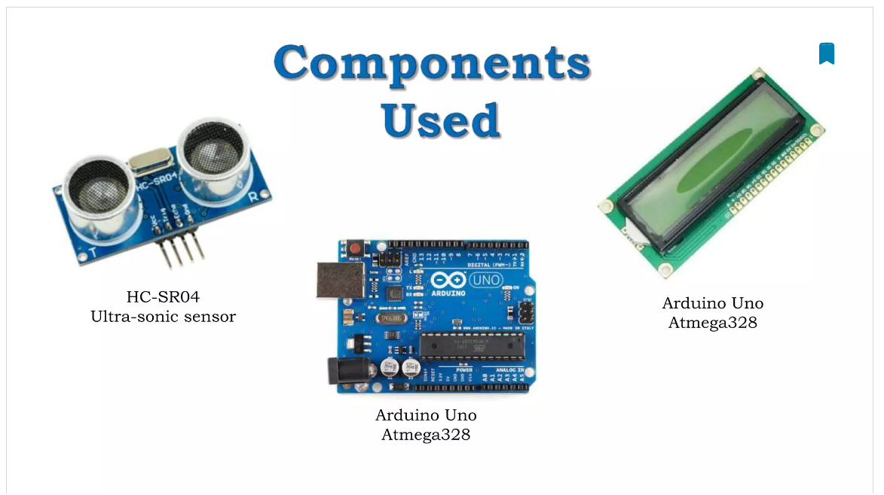

Slide 4
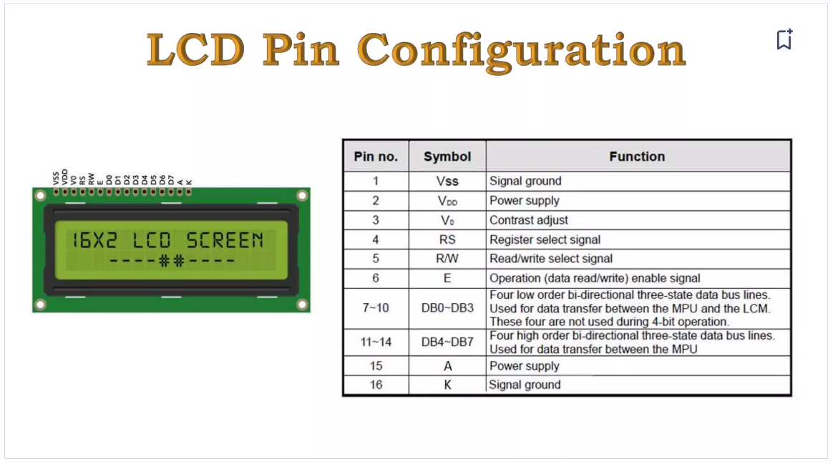
This is a 16x2 LCD display screen with I2C interface. It is able to display 16x2 characters on 2 lines, white characters on blue background. These displays are mainly preferred for multi-segment light-emitting diodes and seven segments.

Slide 5
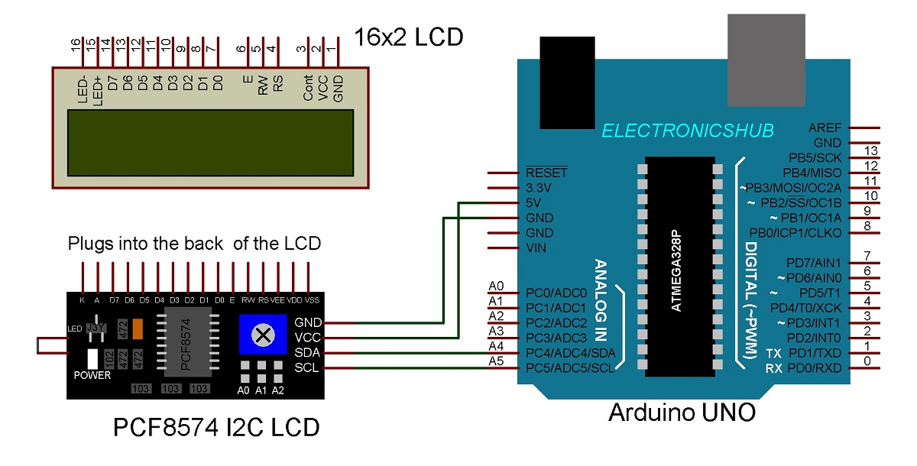

Slide 6
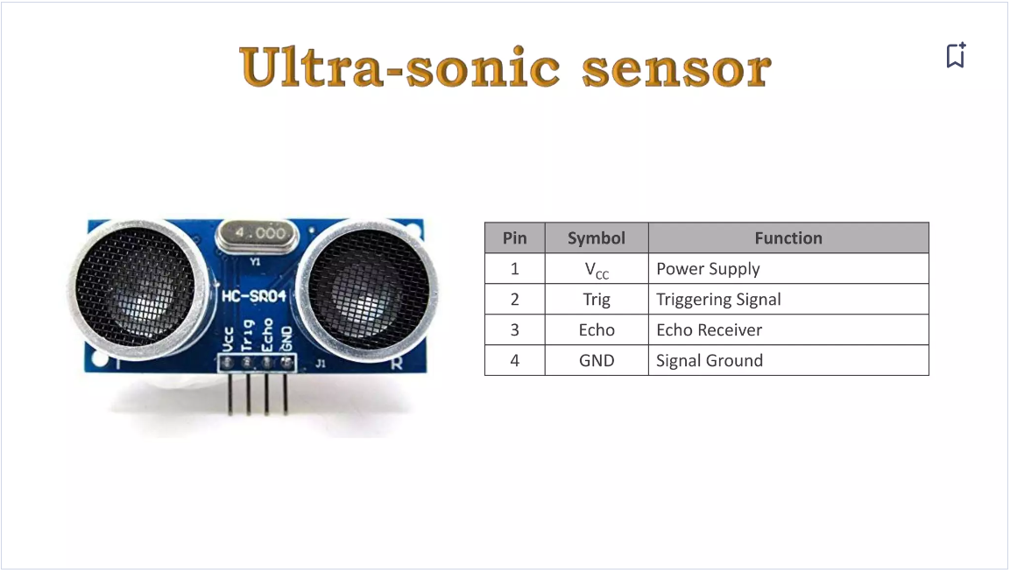
Ultrasonic Sensor: This code utilizes an ultrasonic sensor to measure distance. The sensor emits an ultrasonic sound pulse and then listens for its echo. By measuring the time it takes for the echo to return, the code calculates the distance between the sensor and the object in front of it.

Slide 7
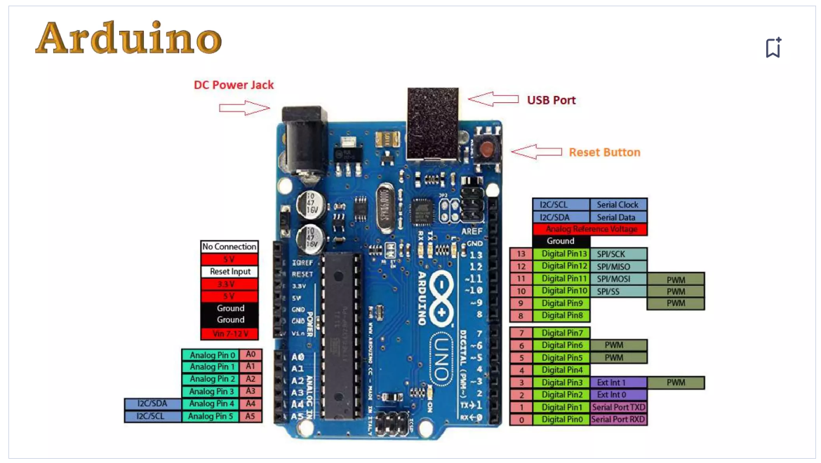

Slide 8
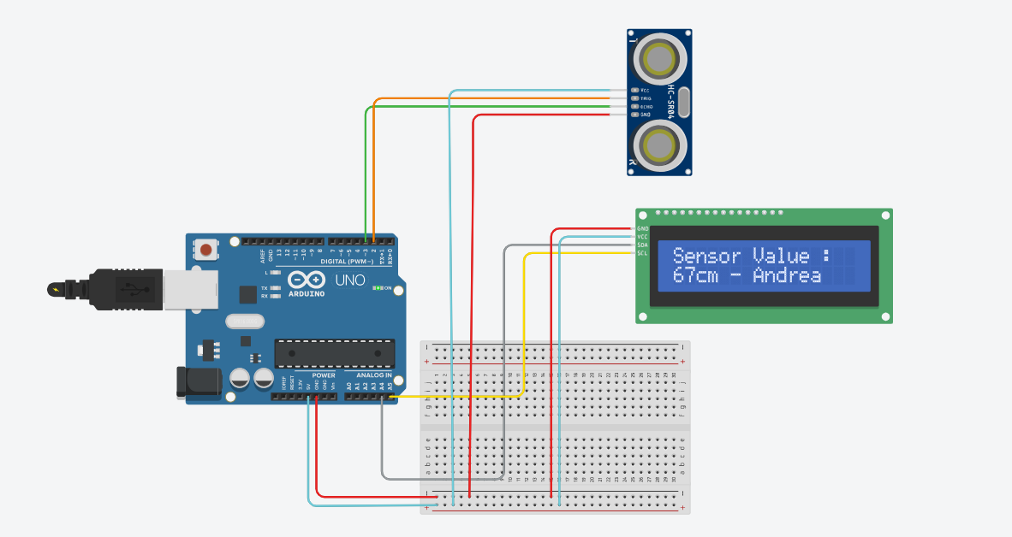
CONNECTIONS

Slide 9
CODE
#include <Adafruit_LiquidCrystal.h> //load liquid crystal library
#define trigPin 2 //Sensor trigger pin connected to ardunio pin 2
#define echoPin 3 // Sensor echopin connected to ardunio pin 3
long duration;
int distance;
Adafruit_LiquidCrystal lcd_1(0);
void setup() {
pinMode(trigPin, OUTPUT);
pinMode(echoPin, INPUT);
Serial.begin(9600);
lcd_1.begin(16,2); //let ardunio to start 16 c 2 r lcd
lcd_1.print("Sensor Value :"); //message on first row
}
void loop() {
digitalWrite(trigPin, LOW);
delayMicroseconds(5);
digitalWrite(trigPin, HIGH);
delayMicroseconds(10);
digitalWrite(trigPin, LOW);
duration = pulseIn(echoPin, HIGH);
distance = duration * 0.034 / 2;
lcd_1.setCursor(0,1);
lcd_1.print(distance);
lcd_1.print("cm - Andrea");
delay(50);
}

Slide 10
Application
Production line robots
Parking sensor of cars
Car washing station
Self driving vehicles

Slide 11
FUTURE SCOPE
The range can be improved by:
Using temperature adjustable devices, it can be used over wide temperature range.
Using High Range Ultrasonic sensors to extend the range of distance measurement.

